Slide 1
M7

Slide 2
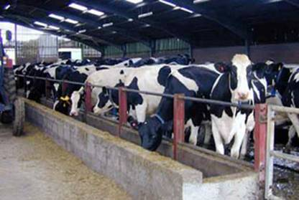
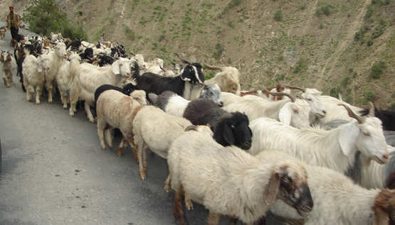
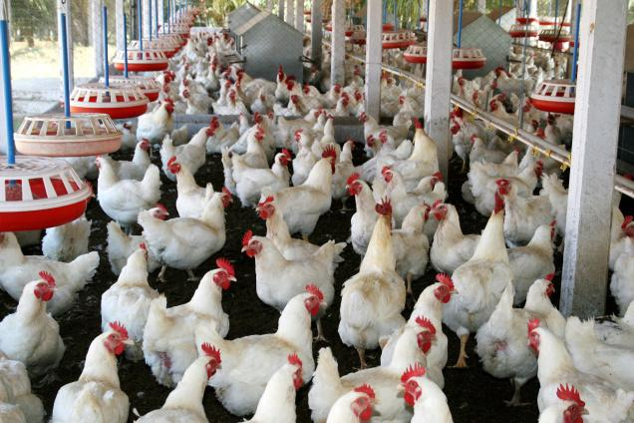
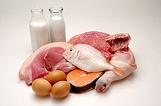
Animal Husbandry :
Animal husbandry is the scientific management of animal livestock.
It includes various aspects such as feeding, breeding and disease control.
Animal-based farming includes cattle, goat, sheep, poultry and fish farming.
As the population increases and as living standards increase, the demand for milk, eggs and meat is also going up.

Slide 3
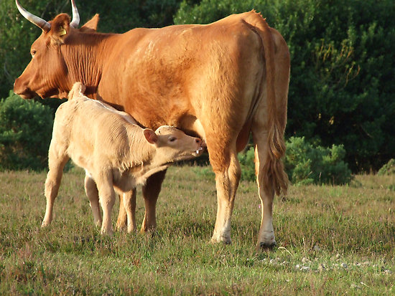
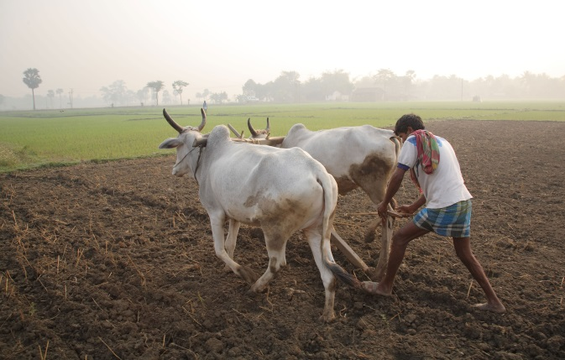
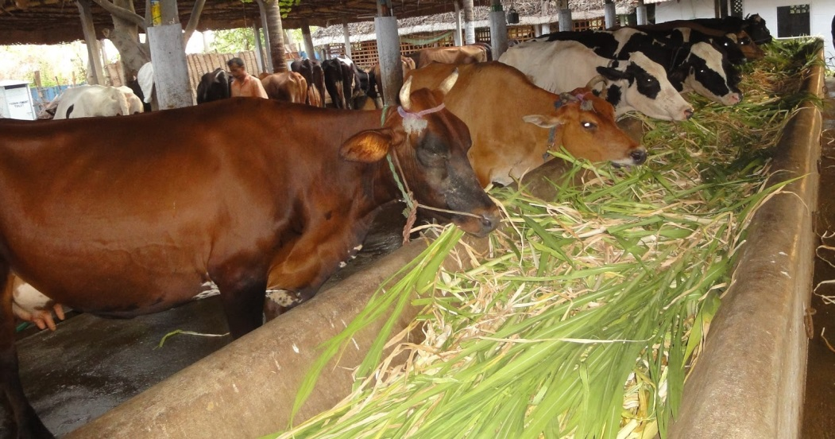
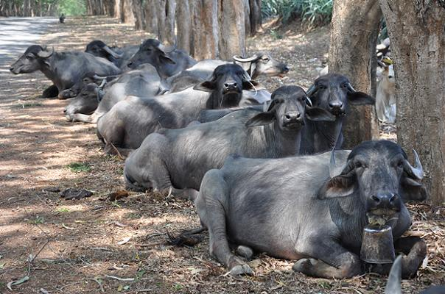
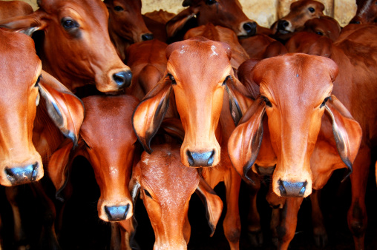
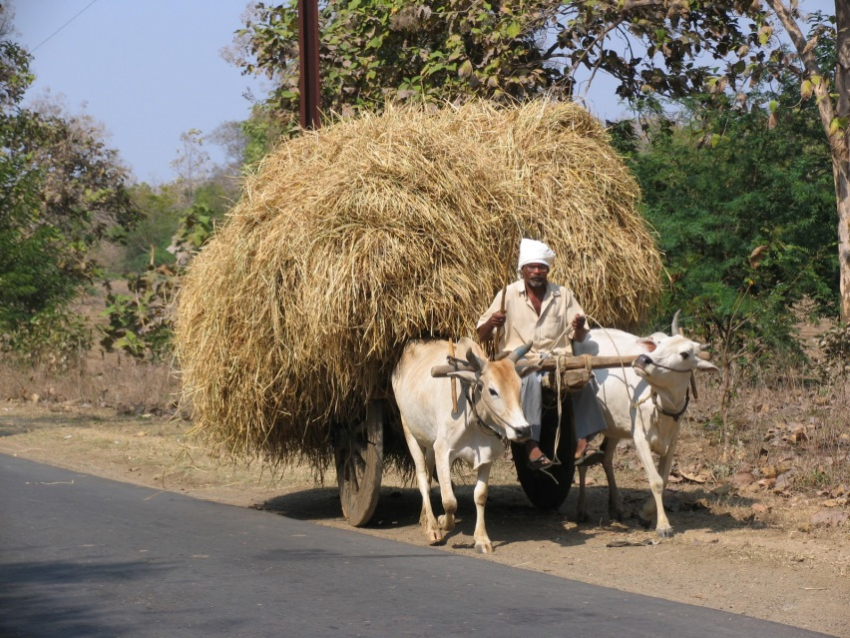



Cattle farming :
Cattle husbandry is done for two purposes — milk and
draught labour for agricultural work such as tilling, irrigation and carting.
Indian cattle belong to two different species, Bos indicus, and Bos bubalis.
cows
Milk-producing females are called milch animals (dairy animals),
buffaloes
while the ones used for farm labour are called draught animals.
Milk production depends, to some extent, on the duration of the lactation period,
period of milk production after the birth of a calf.
So, milk production can be increased by increasing the lactation period.

Slide 4
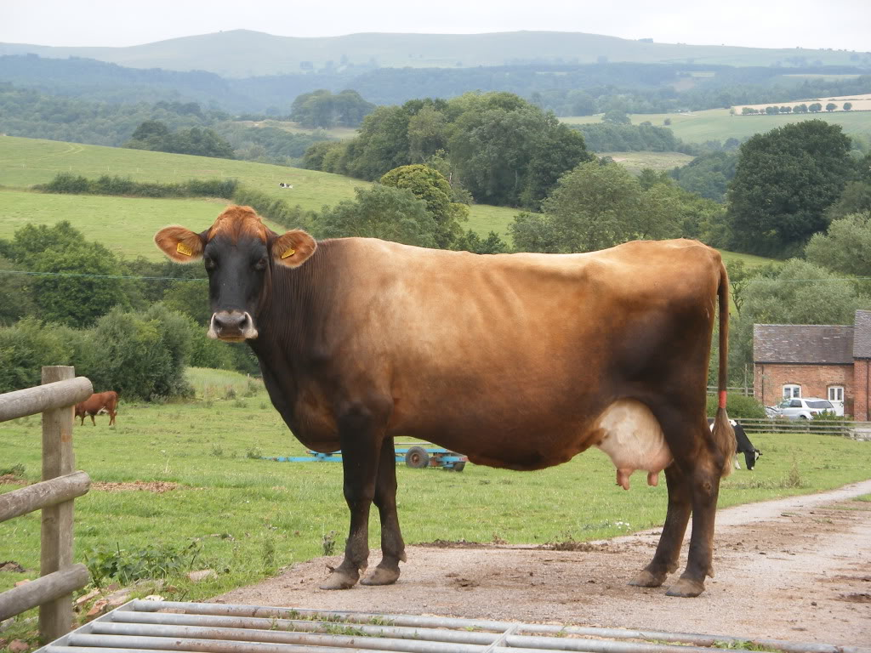
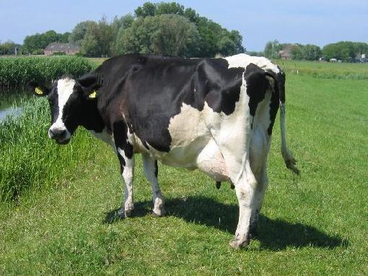
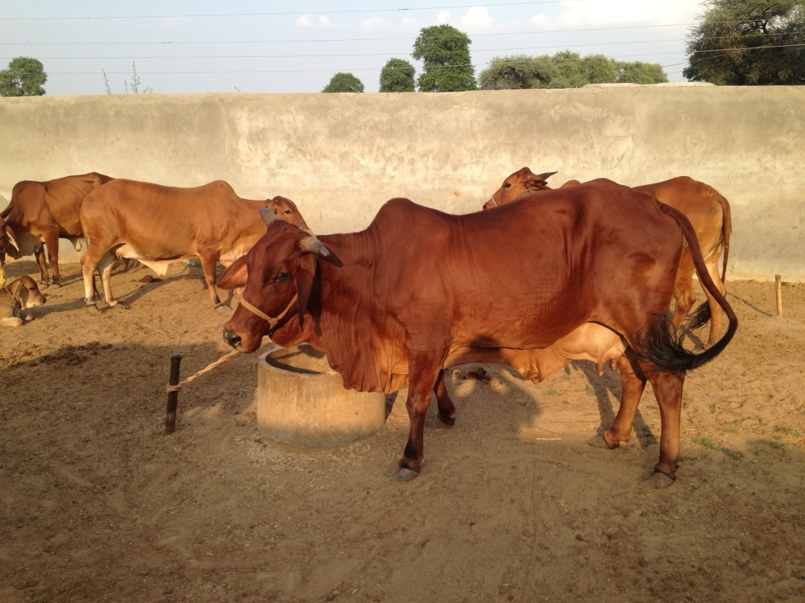
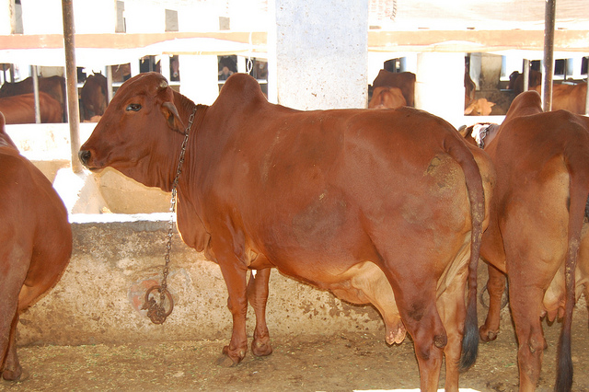
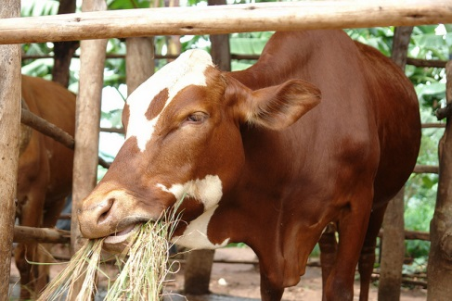
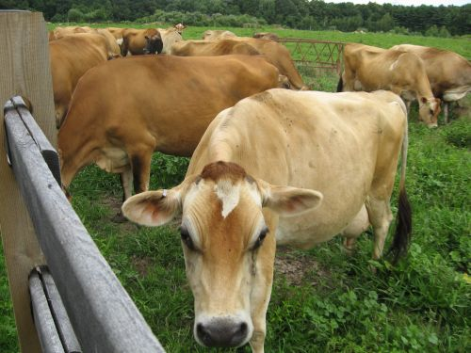
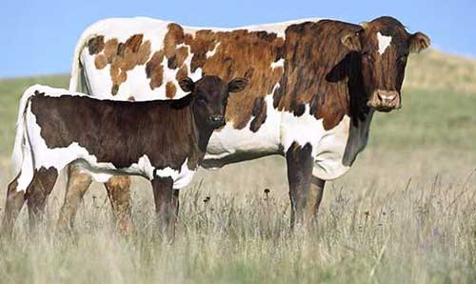
Cattle farming :
Exotic or foreign breeds are selected for long lactation periods,
For example, Jersey,
Brown Swiss.
Local breeds show excellent resistance to diseases.
For example,
Red Sindhi,
Sahiwal.
The two can be cross-bred to get animals with both the desired qualities.

Slide 5
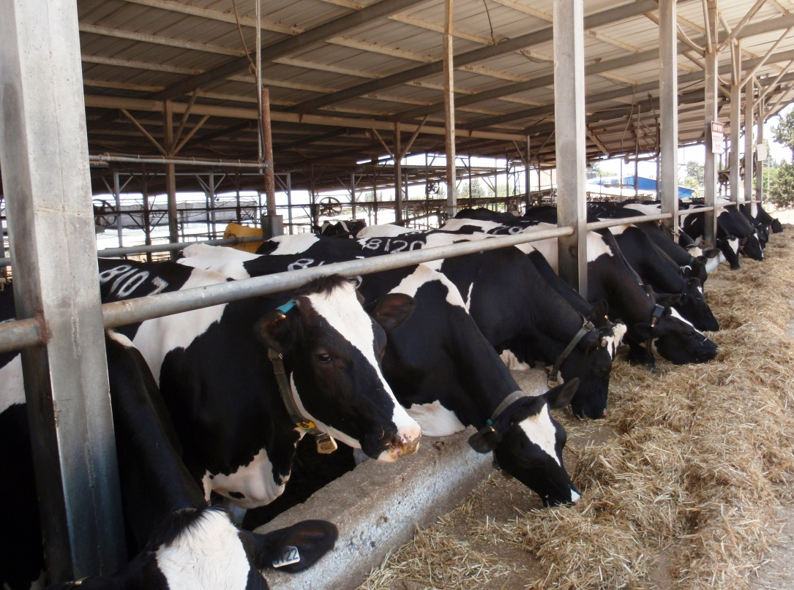
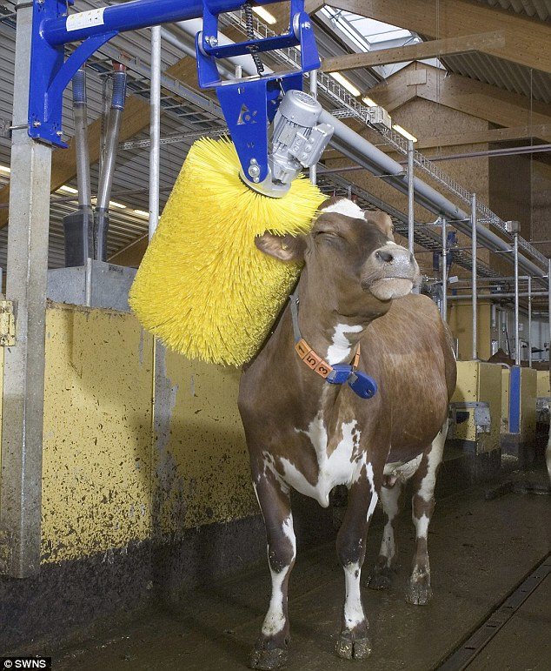
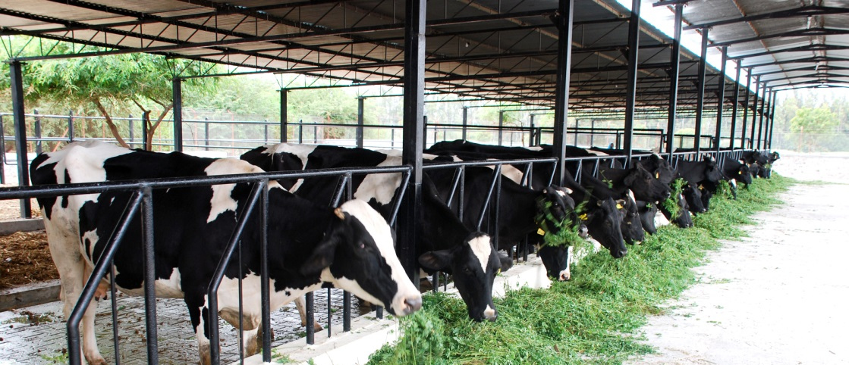
Proper cleaning and shelter facilities for cows and buffaloes are required for humane farming, for the health of the animals and for production of clean milk as well.
Animals require regular brushing to remove dirt and loose hair.
They should be sheltered under well-ventilated roofed sheds that protect them from rain, heat and cold.
The floor of the cattle shed needs to be sloping so as to stay dry and to facilitate cleaning.

Slide 6
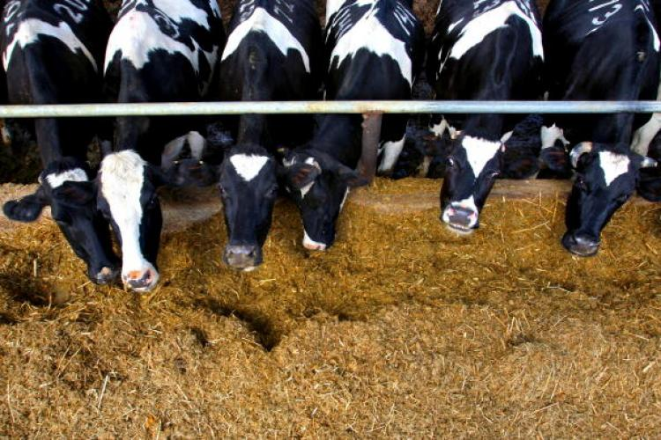
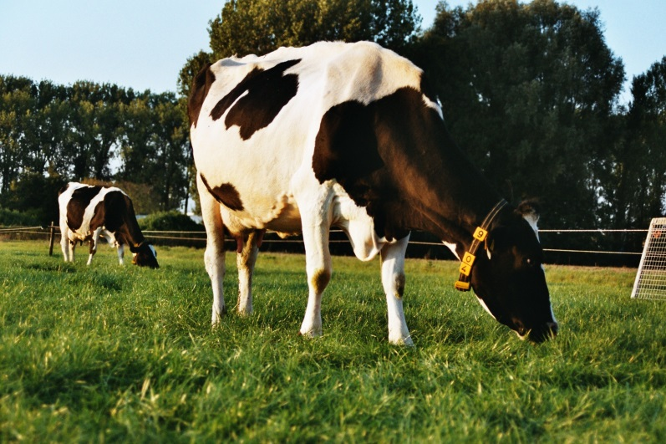
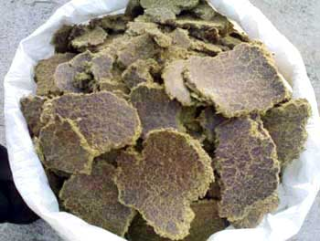
The food requirements of dairy animals are of two types:
(a) Maintenance requirement, which is the food required to support the animal to live a healthy life, and
(b) Milk producing requirement, which is the type of food required during the lactation period.
Animal feed includes:
(a) roughage, which is largely fibre, and
(b) concentrates, which are low in fibre and contain relatively high levels of proteins and other nutrients.

Slide 7
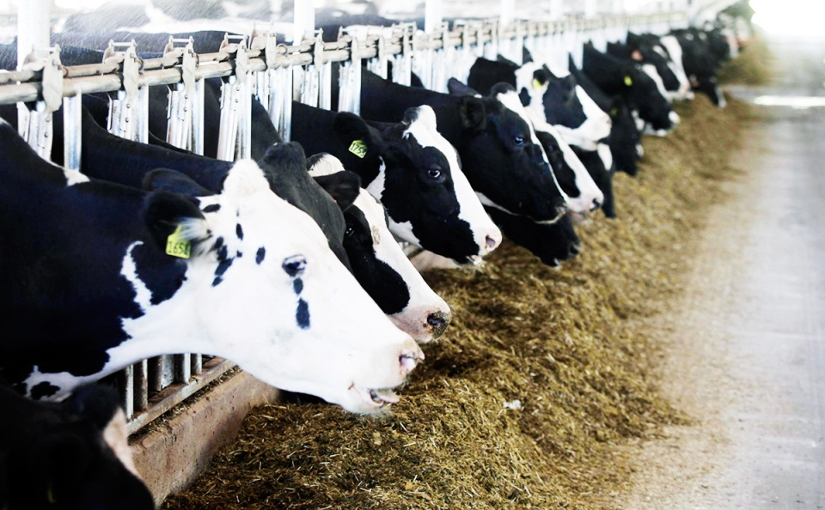
Cattle need balanced rations containing all nutrients in proportionate amounts.
Besides such nutritious food material, certain feed additives containing micronutrients promote the health and milk output of dairy animals.

Slide 8
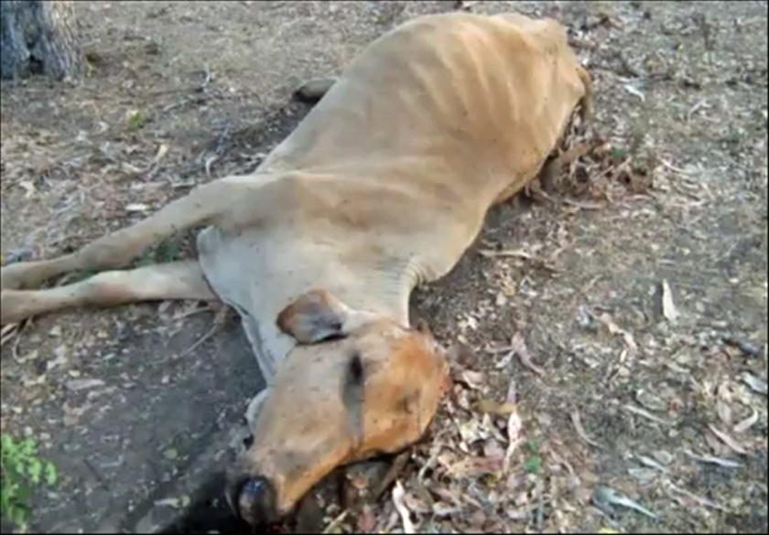
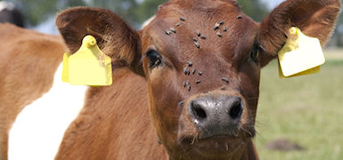
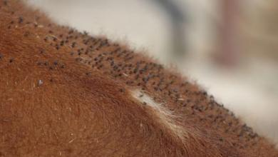
Cattle suffer from a number of diseases.
The diseases, besides causing death, reduce milk production.
A healthy animal feeds regularly and has a normal posture.
The parasites of cattle may be both external parasites and internal parasites.
The external parasites live on the skin and mainly cause skin diseases.

Slide 9
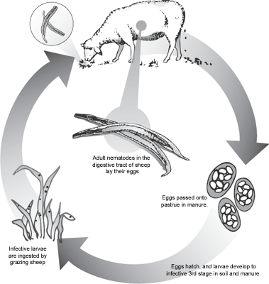
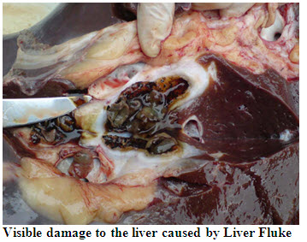
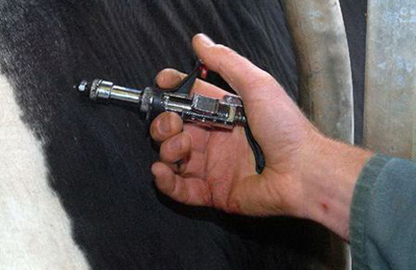
The internal parasites like worms, affect stomach and intestine while flukes damage the liver.
Infectious diseases are also caused by bacteria and viruses.
Vaccinations are given to farm animals against many major viral and bacterial diseases.

